Slide 1


Socket programming (Chat Application)

Slide 2
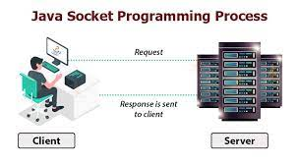

Slide 3
Contents
Network Programming
What are Sockets
Java Packages for Socket Programming
Socket Function Calls
Socket-programming using TCP
Chat Application in Java to understand Socket Programming

Slide 4
Contents Objectives
To build a Basic one-way Client and Server setup
Where a Client connects, sends messages to the server and the server shows them using a socket connection.
To understand the Java API networking package (java.net) and network programming Concepts in Java

Slide 5
Network Programming
The term network programming refers to writing programs that execute across multiple devices (computers), in which the devices are all connected to each other using a network.
The java.net package of the J2SE APIs contains a collection of classes and interfaces that provide the low-level communication details, allowing you to write programs that focus on solving the problem at hand.

Slide 6
What is Socket
A socket is one endpoint of a two-way communication link between two
programs running on the network.
The socket is bound to a port number so that the TCP layer can identify the application that data is destined to be sent.
Transmission Control Protocol (TCP) is a widely used protocol for data transmission on a network that supports client/server end points.

Slide 7
Socket Programming
Socket programming is a means of communicating data between two computers across a network. Connections can be made using either a connection-oriented protocol or a connectionless protocol.

Slide 8
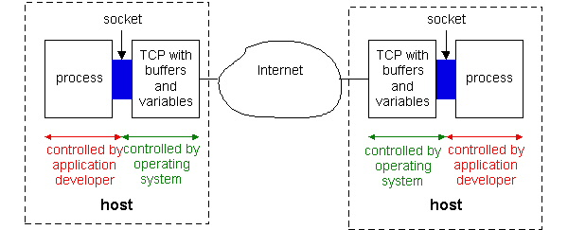
Typical Socket Scenario
Processes communicating through TCP sockets
The application developer has the ability to fix a few TCP parameters, such as maximum buffer and maximum segment sizes.

Slide 9
Client-server applications
Implementation of a protocol standard defined in an RFC. (FTP, HTTP, SMTP…)
Conform to the rules dictated by the RFC (Request for Comments).
Should use the port number associated with the protocol.
Proprietary client-server application.
A single developer( or team) creates both client and server program.
The developer has complete control.
Must be careful not to use one of the well-known port number defined in the RFCs.
Well-known port number : managed by the Internet Assigned Numbers Authority(IANA)

Slide 10
Sockets for server and client
Server
Welcoming socket
- Welcomes some initial contact from a client.
Connection socket
Is created at initial contact of client.
New socket that is dedicated to the particular client.
Client
Client socket
Initiate a TCP connection to the server by creating a socket object. (Three-way handshake)
Specify the address of the server process, namely, the IP address of the server and the port number of the process.

Slide 11
Socket Function Calls
public ServerSocket(int port) throws IOException
- Attempts to create a server socket bound to the specified port
- An exception occurs if the port is already bound by another application.
public Socket accept() throws IOException
- Waits for an incoming client.
- This method blocks until either a client connects to the server on the specified port or the socket times out, assuming that the time-out value
has been set using the setSoTimeout() method. Otherwise, this
method blocks indefinitely.

Slide 12
Socket Function Calls
public void bind(SocketAddress host, int backlog)
- Binds the socket to the specified server and port in the SocketAddress object.
- Use this method if you have instantiated the ServerSocket using the no-argument constructor.
public Socket accept() throws IOException
- Waits for an incoming client.
- This method blocks until either a client connects to the server on the
specified port or the socket times out, assuming that the time-out value
has been set using the setSoTimeout() method.
- Otherwise, this method blocks indefinitely.

Slide 13
Socket Function Calls
public void connect(SocketAddress host, int timeout) throws IOException
This method connects the socket to the specified host.
This method is needed only when you instantiate the Socket using the no-argument constructor.
public Socket accept() throws IOException
- Waits for an incoming client.
- This method blocks until either a client connects to the server on the
specified port or the socket times out, assuming that the time-out value
has been set using the setSoTimeout() method.
- Otherwise, this method blocks indefinitely.

Slide 14
More Socket Function
Write(): write data to a socket
Read(): read data from a socket
sendto(): send a datagram to another UDP socket
recvfrom(): read a datagram from a UDP socket
close(): close a socket (tear down the connection)

Slide 15
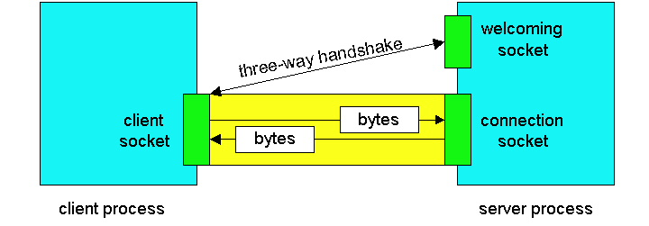
Socket

Slide 16
Socket-programming using TCP
socket( )
bind( )
listen( )
server
client
socket( )
bind( )
connect( )
TCP conn. request
TCP ACK
accept( )
send( )
recv( )
recv( )
close( )
send( )
close( )
controlled by
application
developer
process
process
socket
controlled by
operating
system
TCP with
buffers,
variables
socket
TCP with
buffers,
variables
internet

Slide 17
Client/server socket interaction: TCP
Server (running on hostid)
Client
create socket,
port=x, for
incoming request:
welcomeSocket =
ServerSocket()
TCP
connection setup
create socket,
connect to hostid, port=x
wait for incoming
connection request
connectionSocket =
welcomeSocket.accept()
clientSocket =
Socket()
send request using
clientSocket
read request from
connectionSocket
write reply to
connectionSocket
read reply from
clientSocket
close
connectionSocket
close
clientSocket

Slide 18
JAVA TCP Sockets
In Package java.net
java.net.Socket
Implements client sockets (also called just “sockets”).
An endpoint for communication between two machines.
Constructor and Methods
Socket(String host, int port): Creates a stream socket and connects it to the specified port number on the named host.
InputStream getInputStream()
OutputStream getOutputStream()
close()

Slide 19
JAVA TCP Sockets
In Package java.net
java.net.ServerSocket
Implements server sockets.
Waits for requests to come in over the network.
Performs some operation based on the request.
Constructor and Methods
ServerSocket(int port)
Socket Accept(): Listens for a connection to be made to this socket and accepts it. This method blocks until a connection is made.

Slide 20
Socket I/O
Socket I/O is based on the Java I/O support
in the package java.io
InputStream and OutputStream are abstract classes
common operations defined for all kinds of InputStreams, OutputStreams…

Slide 21
Socket Programming Types
Java Socket programming can be connection-oriented or connection-less.
Socket and ServerSocket classes are used for connection-oriented socket programming and
DatagramSocket and DatagramPacket classes are used for connection-less socket programming.

Slide 22
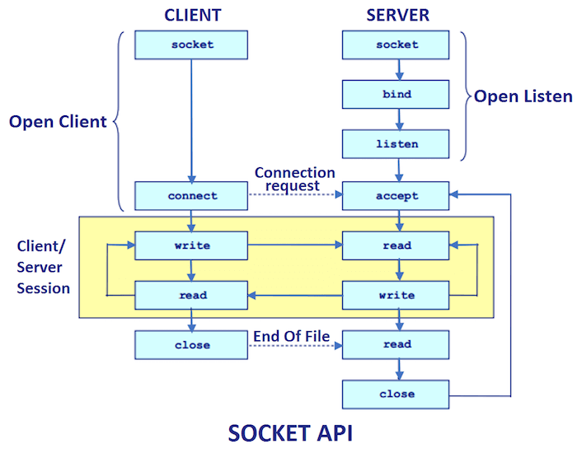
Socket API

Slide 23
Socket I/O
A Complete Example

Slide 24

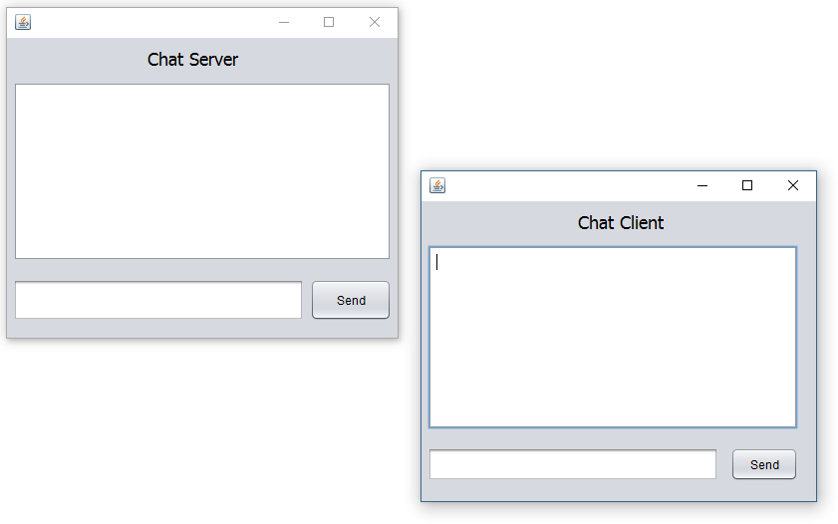
Chat Application using socket

Slide 25
Java Packages for Socket Programming
import java.io.DataInputStream;
import java.io.DataOutputStream;
import java.net.ServerSocket;
import java.net.Socket;

Slide 26
Steps for Creating Server
Create Server Socket
Accept Socket Incoming Connection
Prepare DataInputStream
Prepare DataOutputStream

Slide 27
Creating Server
Create Server Socket
To create the server application, we need to create the instance of ServerSocket class.
Here, we are using 1201 port number for the communication between the client and server. You may also choose any other port number.
The accept() method waits for the client. If clients connects with the given port number,
it returns an instance of Socket.

Slide 28
Initialization (Server)
Server
static ServerSocket ss;
static Socket s;
static DataInputStream din;
static DataOutputStream dout;

Slide 29
Creating Server
ServerSocket ss=new ServerSocket(1201);
//establishes connection and waits for the client
ss.accept();

Slide 30
Server side
Read Message from Stream
Display Message on Screen
Read Message from Screen
Write Message to Stream

Slide 31
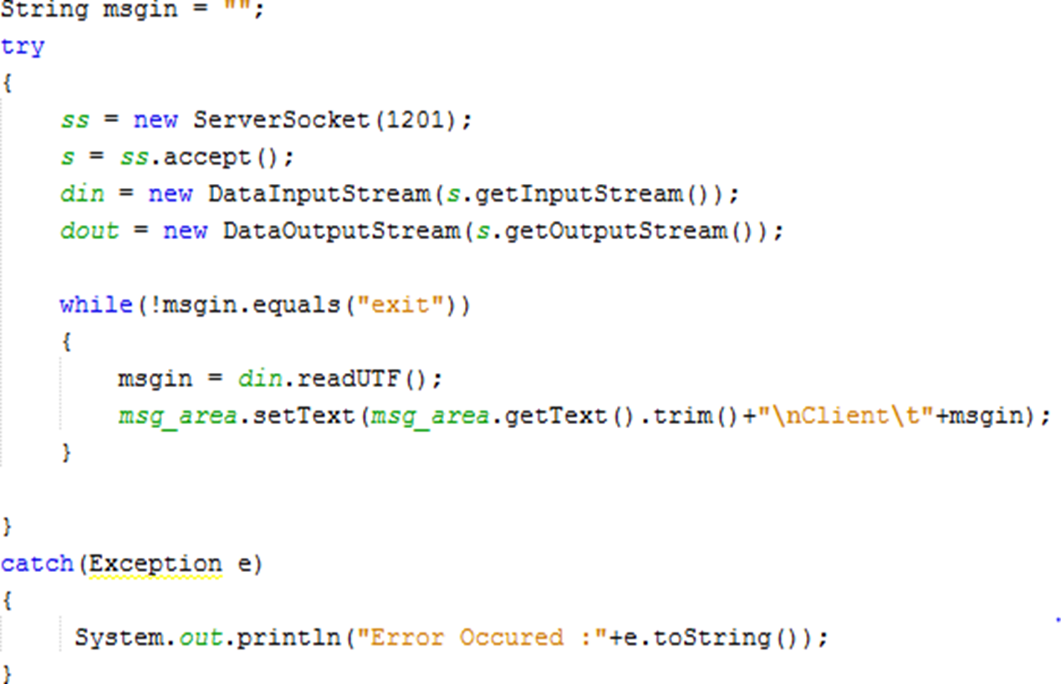
Server code

Slide 32
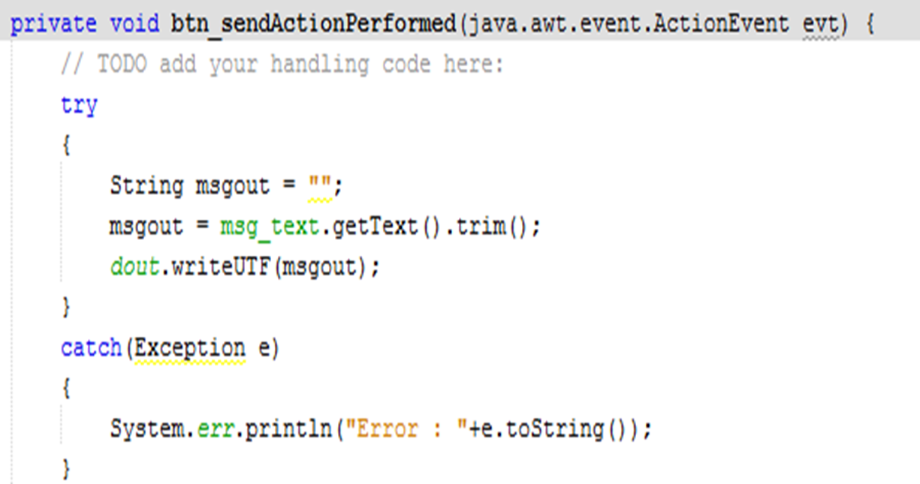
Server send code

Slide 33
Steps for Creating Client
Create and Connect Socket
Prepare DataInputStream
Prepare DataOutputStream

Slide 34
Initialization (Client)
static Socket s;
static DataInputStream din;
static DataOutputStream dout

Slide 35
Creating Client
To create the client application, we need to create the instance of Socket class.
Here, we need to pass the IP address or hostname of the Server and a port number.
Here, we are using "localhost" because our server is running on same system.

Slide 36
Creating Client
The client has to know two things about the server
- The server’s IP address
- The port number.
Ports between 0 and 1023 are mainly used for administrative purpose (e.g., 21 for FTP, 23 for Telnet, 25 for email, and 80 for HTTP). In our program, we’ll be using port number 5000.

Slide 37
Creating Client
s=new Socket(“localhost”,1201);

Slide 38
Client side
Read Message from Stream
Display Message on Screen
Read Message from Screen
Write Message to Stream

Slide 39
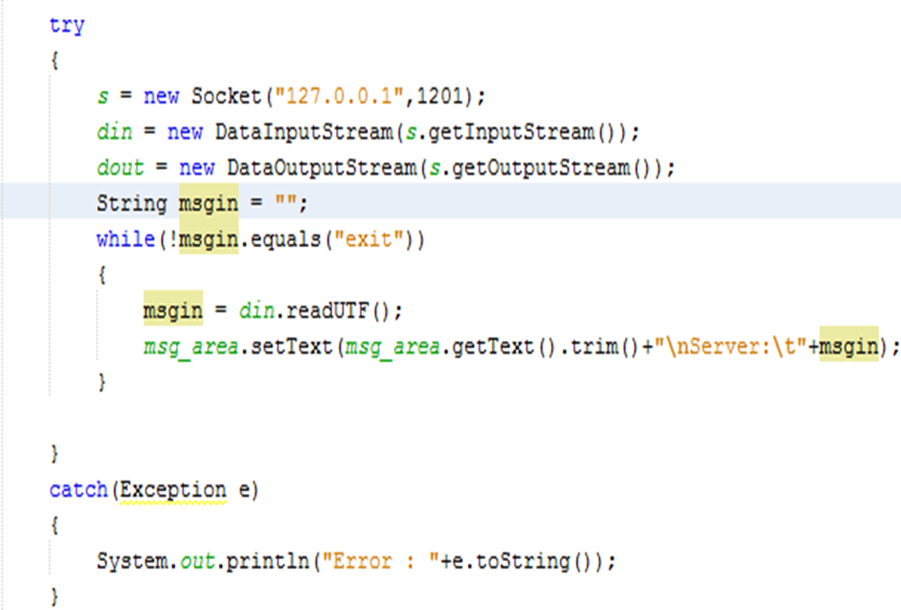
Client code

Slide 40

Client send code

Slide 41
Socket Programming References
Java-tutorials:
“All About Sockets” (Sun tutorial), http://www.javaworld.com/javaworld/jw-12-1996/jw-12-sockets.html
“Socket Programming in Java: a tutorial,” http://www.javaworld.com/javaworld/jw-12-1996/jw-12-sockets.html

Slide 42
More Examples
You can download more sample programs here:
http://www.cs.uic.edu/~troy/spring05/cs450/sockets/socket.html

Slide 43
Any Question
THANK YOU ☺

